Slide 1
Zebra & Quagga Mussels

Slide 2
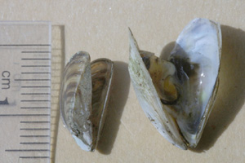
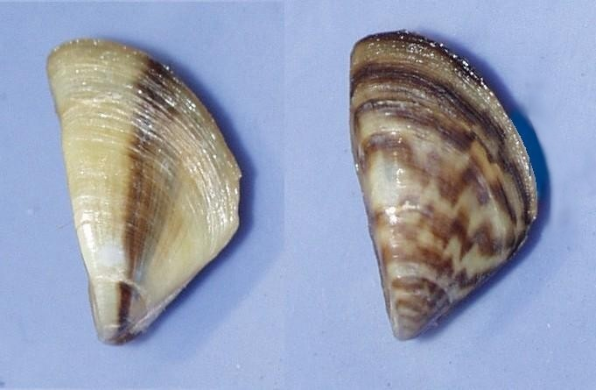
Exotics: Zebra & Quagga Mussels
Zebra & Quagga Mussels
Dreissena polymorpha
First Invader
Dreissena bugensis
Bigger - Better - Deeper
Invaded North America
Suitable Habitat
-2 to 40°C Water
Origins
Eastern Europe
Migrated through Western Europe (1830)
Parallel Increase Commerce

Slide 3
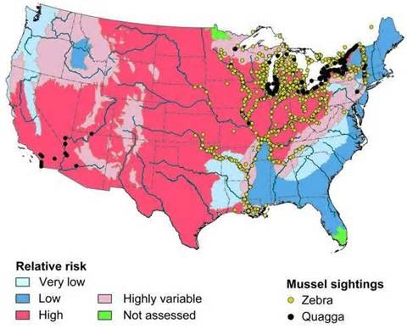
North America
1988 – Zebras First Found
Lake St Clair
Between Huron/Erie
Outside Detroit Harbor
Imported
Ship’s Ballast Water
Now Dominates Ecosystems
1992 – Zebras First Found
Seneca Lake
Later Most Finger Lakes
2002

Slide 4
Cementation
Economic Problem
Water Intake Pipes
Drinking Water
Cooling Water
Nuclear Power Plants
Cover Boats, etc.
Removal
Poisons
Chlorine
Ozone
Hammer/Chisel
Hot Water > 35°C

Slide 5
Seneca Lake Water Transparency
Nutrient Loading
Zebra Introduced
Zebra Die Off
Zebra & Quagga Rebound

Slide 6
Zebra Mussel Impact? A Simple Nutrient Cycle
Plankton
Dissolved Nutrients
Fish (Lake Trout) & Other Organisms
Bacterial Decomposition
Dead Organics
Pre-Zebras

Slide 7
Zebra & Quagga Mussel Impact on Nutrient Cycle
Plankton
Dissolved Nutrients
Zebra & Quaggas
Fish (Lake Trout) & Other Organisms
Bacterial Decomposition
Dead Organics
Pre-Zebras
Post Zebras

Slide 8
Zebra & Quagga Mussel Impact on Nutrient Cycle
Plankton
Dissolved Nutrients
Zebra & Quaggas
Fish (Lake Trout) & Other Organisms
Bacterial Decomposition
Dead Organics
Pre-Zebras
Post Zebras
Death 1st Wave

Slide 9
Seneca Lake Water Transparency
Nutrient Loading
Zebra Introduced
Zebra Die Off
Zebra & Quagga Rebound

Slide 10
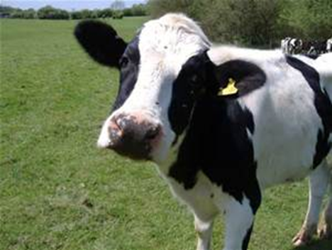
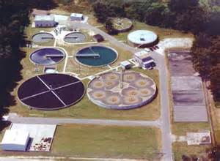
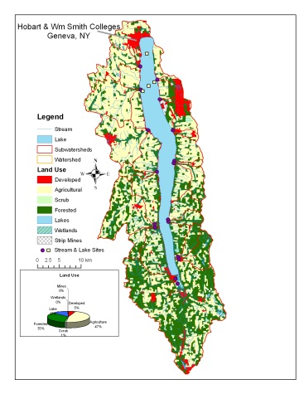
Seneca Lake: Nutrient Loading
Wastewater
Treatment
Agricultural
Agricultural
Agricultural
Ag//Forested
Forested
Forested
Forested
Army Depot – Pig Farms
Phosphate is Limiting. P:N Algae 1:7, In Lake 1:200

Slide 11
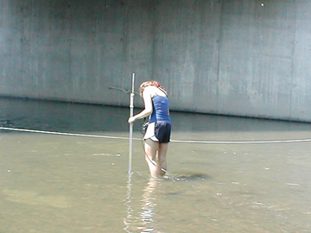
Annual Loading by Source - 2011
Seneca: Surplus 45 mt/yr
Sources Streams – 40 mtons/yr Atmosphere – 1 mtons/yr Municipal WWTF – 2.5 mtons/yr Septic Systems – 5 mtons/yr Lawn Care?
Sinks Outlet – 8 mtons/yr Sediment – 1.5 mtons/yr

Slide 12
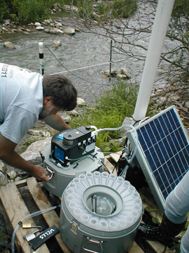
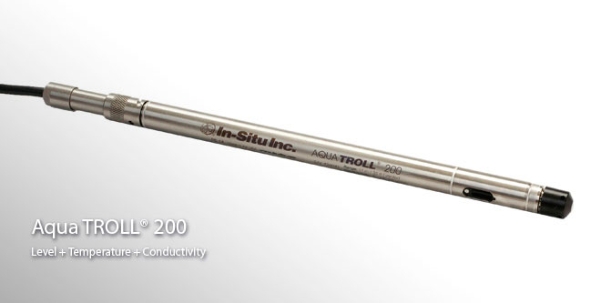
Nutrient Delivery Owasco Lake
Dutch Hollow Autosampler 3 Water Samples/Day
Dutch Hollow Hourly Readings Stage, Cond., Temperature

Slide 13
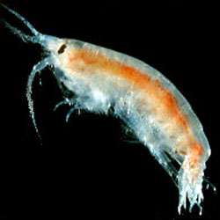
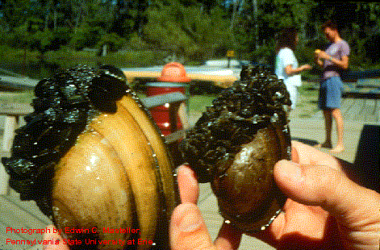
Ecological Disruption
Lake Ontario
Diporeia
Whitefish
Lake Trout
Native Shell Species
Snuffed Out

Slide 14
What Should be Done?
Anything?
Residential Surveys
Local Economics - Tourism

Slide 15
100 or so Amazing Students
Nadine Acquisto (WS’95)
David Cohn (H'95)
Mary Gibbons-Neff (WS'97)
Keri Lesniak (WS'97)
Andrea Pulver (WS'97)
Jennifer McKnight (WS'97)
Damian Herrick (H'97)
Ethan Prout (H'97)
Andrew Babaian (H'97)
Theron Bond (H'97)
Matthew Lamana (H'97)
Matthew Nuzzo (H'97)
John Fiori (H'97)
Kathleen Maloney (WS'98)
Robert Dedrick (H'98)
Thomas Sardella (H'98)
David Went (H'98)
Jason Christensen (H'98)
Jason Farnung (H'98)
Nathan Kranes (H'98)
Kathryn Hammontree (WS’99)
Megan LeBoutillier (WS’99)
Kevin Farr (H’99)
Andrew Dominick (H’99)
Miki Alroy (H’99)
John Vandemoer (H’00)
Jon Rumpf (H’00)
MaryBeth Giancarlo (WS’00)
Arthur (Trey) Driscoll (H’00)
Micah Nicolo (H’01)
Timothy Riley (H’01)
Derith Hart (WS’01)
N. Scott Alderman (H’01)
Lindsay P. Bowser (WS’02)
Margaret Etherington (WS’02)
Laura Calabrese (WS’02)
Sandy Baldwin (WS’02)
Robert Stewart (H’03)
Emily LaDuca (WS’04)
Caterina Caiazza (WS’05)
Ann Walker (WS’05)
Barbara Beckingham (WS’05)
Sarah Kostick (Smith, ’05)
John Riina (H’05)
Doug Wood (H’05)
Katie Bush (WS’06)
Clare Morgan (WS’06)
Suzanne Opalka (WS’06)
Ian West (H’06)
Rachel Sukeforth (WS’07)
Brittany Holler (WS’08)
Tara Ware (WS’08)
Evan Brown (H’08)
Christina Kinnevey (WS’09)
Kerry O‘Neill (WS’09)
Clancy Brown (WS’09)
Rachael Dye (WS’10)
Casey Franklin (WS’10)
Samuel Georgian (H’10)
Prabighya Basnet (WS’11)
Katherine Hoering (WS’11)
Emily Cummings (WS’12)
Maggie Stewart (WS’12)
Abby Kent (WS’12)
Laura Carver Dionne (WS’13)
Ethan Brown (H’13)
Carli Ellis (WS’14)
Phillip Hackett (H’14)
Ali Cole (WS’14)
Tyler (TJ) Goldstoff (H’15)
Genny Morales (WS’15)
Nikki Andrzejczyk (WS’16)
Kat Coughlin (WS’16)
Abby Dylag (WS’16)
Nicole Tanquary (WS’17)

